Slide 1
Computer Networks
Khizar Mukhtiar
Lecturer, CS Department

Slide 2


Certificates
A certificate is a document that links someone’s identity to their public key
  Certificates are issued and signed by trusted Certification Authorities (CA)
Certificate
Bob’s ID info
Bob’s public key
CA info
CA Signature
Hashed and encrypted using CA private key
Hashed
Verify
Decrypted using CA public key
Knowing the public key of the CA is sufficient to verify all the certificates that it issues
No party except for the CA can modify the certificate without being detected

Slide 3




Public-Key Certificates
Alice
Bank
Alice verifies the validity of the certificate.
Send me your certificate
plaintext
Here’s my certificate
Let’s use this key
RSA
Alice confirms that the certificate has not been revoked.
OK
Here’s my login password
AES
You’re in!

Slide 4
Certificates
A piece of information that proves the identity of a public-key’s owner.
  Signed and delivered securely by a trusted third party entity called a Certificate Authority (CA)
A Certificate contains
  CA’s identity
  Owner’s identity
  Owner’s public-key
  Certificate expiry date
  CA’s signature of that certificate
  …
With a certificate instead of a public key
  A recipient can verify a few things about the issuer

Slide 5
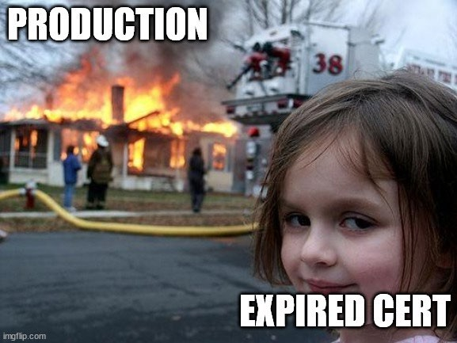
Certificates and expiration…
Expiring certificates are a pain
It is very tempting to create certificates that will last forever
BAD practice!

Slide 6
And why do we need the s in https?

Slide 7
Why is it always bowling websites?
Video: anatomy of an IoT attack
Among others the hacker exploited a (very old) bowling website

Slide 8
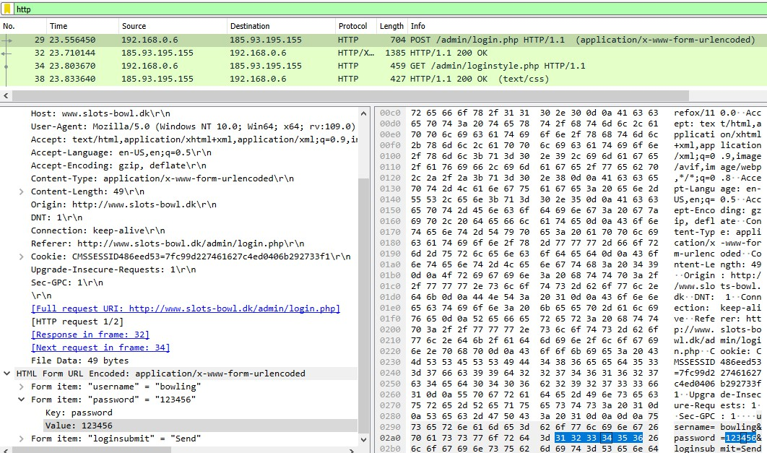
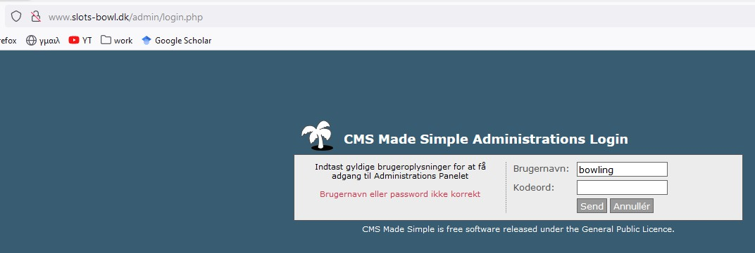
Without “s” in http – data transmitted in plaintext
– Let try some random credentials…

Slide 9
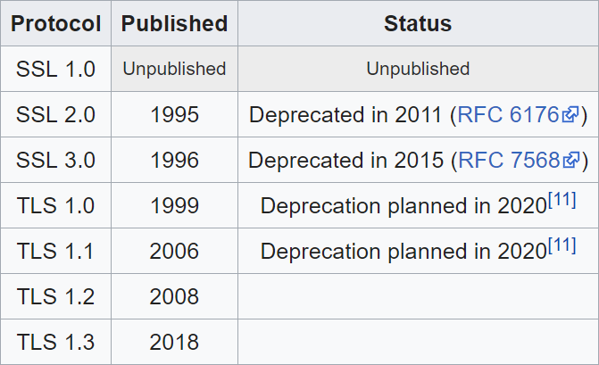
On the ambiguity of names
SSL: Secure Sockets Layer
TLS: Transport Layer Security
TLS is a newer version of SSL
– For political/historical reasons SSL is still used/mentioned

Slide 10
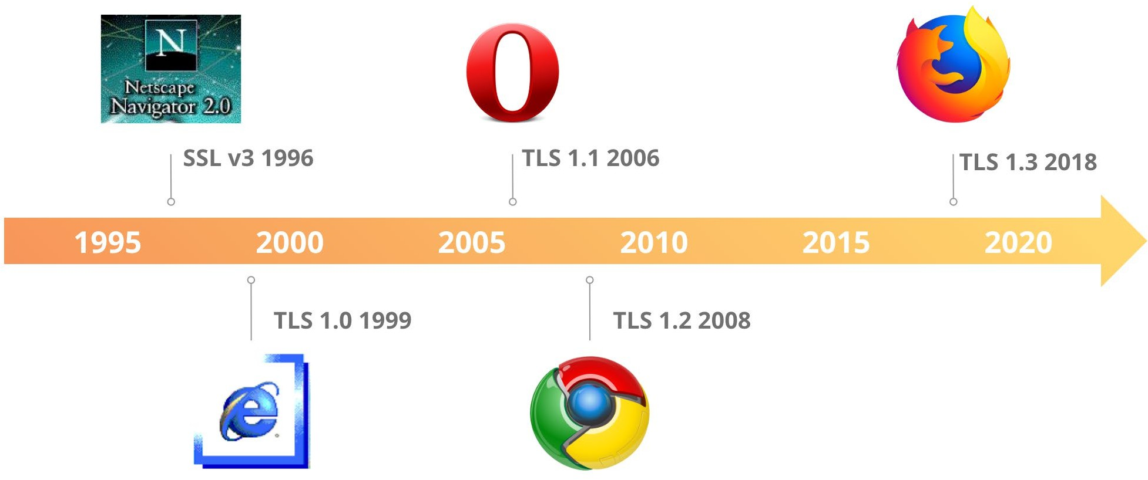
On the ambiguity of names
Network security course

Slide 11
What does it do?
Confidentiality
– Encryption of a session (e.g., via DH-RSA)
Authentication (via certificates)
– Is valid for the same domain as the one being accessed
– Has been issued by a trusted CA (Certificate Authority)
– Is valid and not passed its expiration date
Data integrity
Forward secrecy
–(most of the time; depends on protocol version and settings)
Network security course

Slide 12
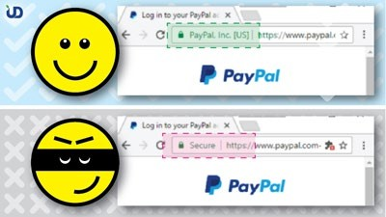
What it doesn’t do
Privacy/Anonymity
  Everyone knows that A communicates with B
  They don’t know the content of the communication
It doesn’t make a website “safe”
  Anyone can create an SSL/TLS certificate
It doesn’t mean that the data saved on the server is encrypted too
(also sometimes protocol ≠
implementation)
Network security course

Slide 13
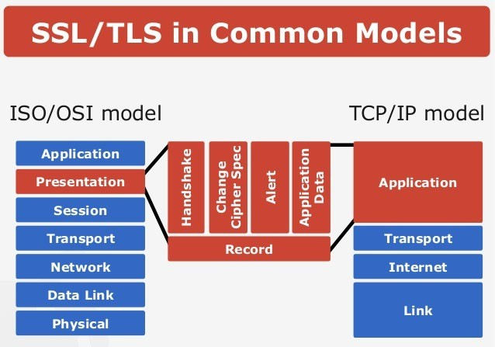
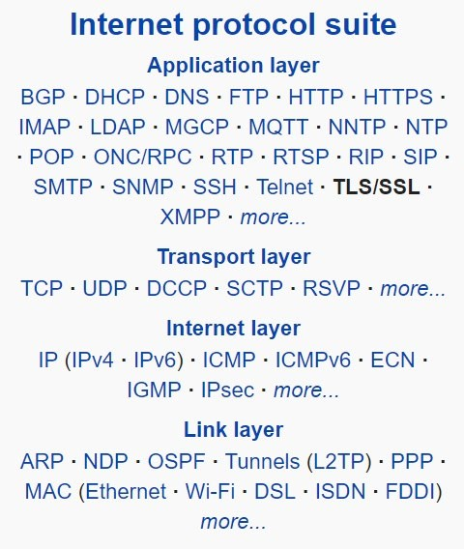
TLS at a glance
A protocol offering various security properties
Network security course

Slide 14
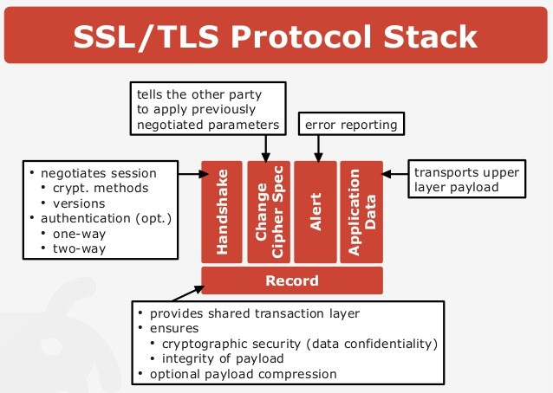
TLS at a glance
Network security course

Slide 15

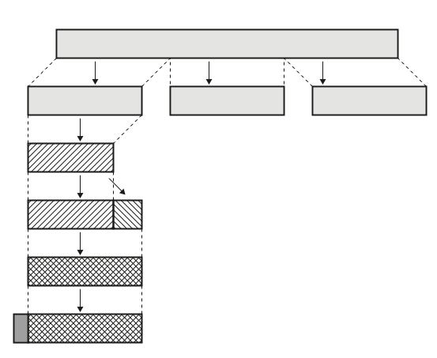
TLS Record Protocol
The Record
Protocol takes messages
to be
transmitted, manageable
fragments the data
into
blocks,
optionally compresses
the data, applies
a MAC, encrypts, and
transmits the result
(For the receiver’s end: received data is verified, decrypted, reassembled, and then delivered to higher-level clients)

Slide 16

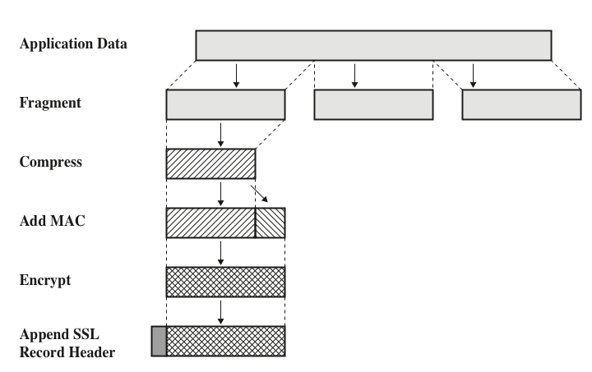
TLS Record Layer
2¹⁴ bytes
2¹⁴ bytes
Or less
Optional
Shared key is used to calculate Message Authentication Code
Network security course

Slide 17
TLS at a glance
TLS Handshaking Protocols
Network security course

Slide 18
TLS Higher Layer sub-protocol
Change Cipher Spec
  Notify the receiving party that subsequent records will be protected under the just-negotiated CipherSpec and keys
  Only one byte long, and signals the change in communications protocol by having a value of ‘1’
  Exists only in TLS versions <=1.2
Alert –Sends errors, problems or warnings about the connection. This layer is formed with two fields:
  Severity Level: value 1 (warning) or 2 (fatal error; discontinue session)
  Alert Description: indicates the specific error that caused the Alert Message to be sent from a party. This field is one byte, mapped to one of twelve specific numbers (e.g., handshakeFailure, BadCertificate, CertificateRevoked, etc.)
Network security course

Slide 19
TLS Handshake
Allows server/client to authenticate each other and negotiate an encryption and MAC algorithm and cryptographic keys
Used before any application data is transmitted
Each message has three fields
  Type (1 byte) – Indicates one of the 10 messages (see next slide)
  Length (3 bytes) – the length of the message in bytes
  Content (> 0 bytes) – the parameters associated with this message
Network security course

Slide 20
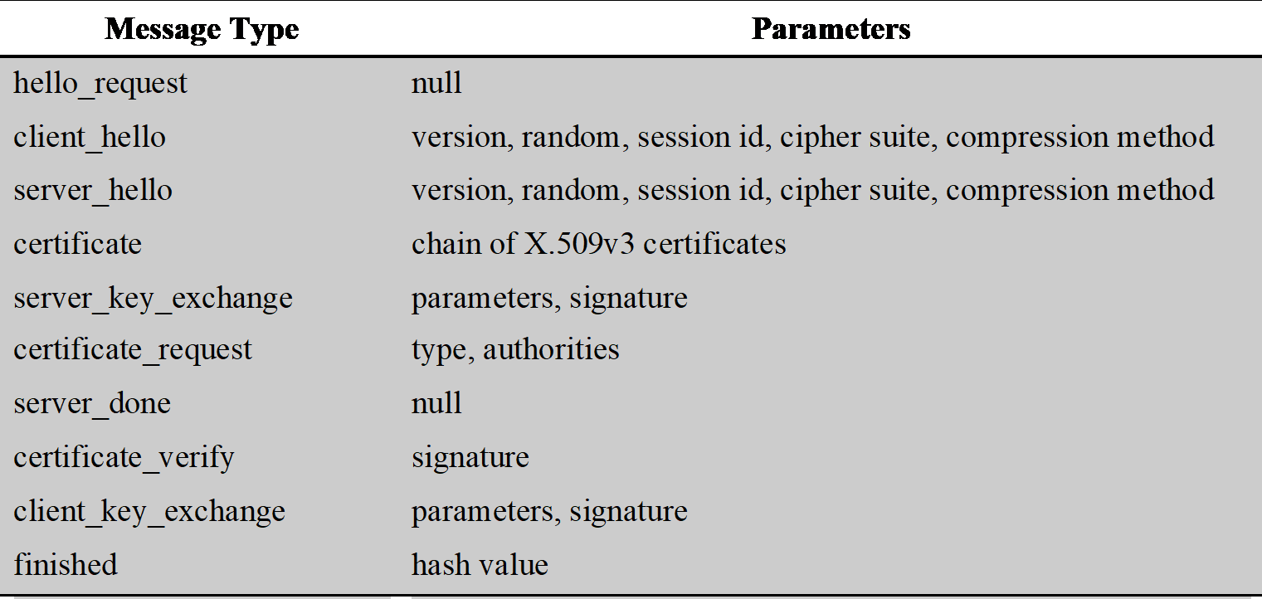
TLS Handshake Protocol Message Types
Network security course

Slide 21




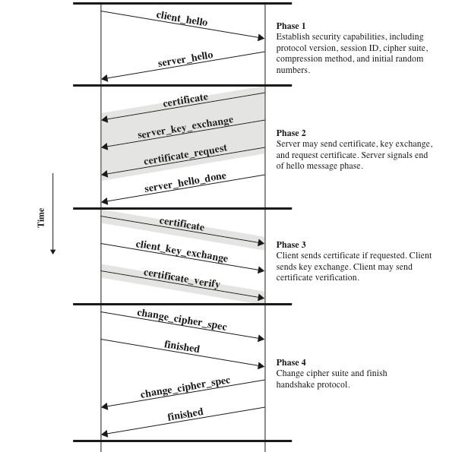
Handshake Protocol Action (TLS <=1.2)
Alice
Server
Network security course

Slide 22
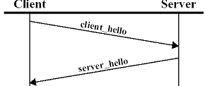
Phase 1 – Establish Security Capabilities
Used to initiate a logical connection and to establish the security capabilities that will be associated with it
  Exchange is initiated by the client with following parameters:
    Version
    Random
    Session-ID
    CipherSuite
    Compression Method
First element in the CipherSuite is Key exchange method
  RSA, Fixed Diffie-Hellman, Ephemeral Diffie-Hellman, Anonymous Diffie-Hellman, Fortezza
Network security course

Slide 23
Handshake Protocol Action (TLS <=1.2)
Alice
Server
Network security course

Slide 24
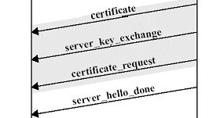
Phase 2– Server Authentication and Key Exchange
Server begins this phase by sending its certificate if it needs to be authenticated
  Message contains one chain of certificates
Next Message “server_key_exchange message”
  The message is not required if the server has sent a certificate with fixed Diffie-Hellman Parameters or RSA key exchange is to be used
Certificate_request message
  Includes two parameters – certificate_type and certificate_authorities
Final message “server_done message”
  Sent by the server to indicate the end of the server hello and associated messages
Server waits for a client response
Network security course

Slide 25
Handshake Protocol Action (TLS <=1.2)
Alice
Server
Network security course

Slide 26
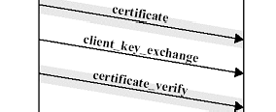
Phase 3– Client Authentication and Key Exchange
Client verifies that the server provided a valid certificate
Checks that the parameters are acceptable
If requested by the server client sends its own certificate
Next message “client_key_exchange message”
  Contents of message depends on the type of the key exchange
Final message “certificate_verify message”
  Provide verification of a client certificate
Network security course

Slide 27
Handshake Protocol Action (TLS <=1.2)
Alice
Server
Network security course

Slide 28


Phase 4– Finish
This phase completes the set up
Client send a change_cipher_spec message
  Copies the pending CipherSpec into the current CipherSpec
Client sends the finished message under the new algorithms, keys, and secrets
  Verifies that that the key exchange and authentication process was successful
Similar response from the server side
  The client and the server can begin to exchange application-layer data
Network security course

Slide 29
Heartbeat Protocol
–Periodic message exchange to keep connection alive
Used in popular TLS library implementations
problem: no bound checks on heartbeat messages
Network security course

Slide 30
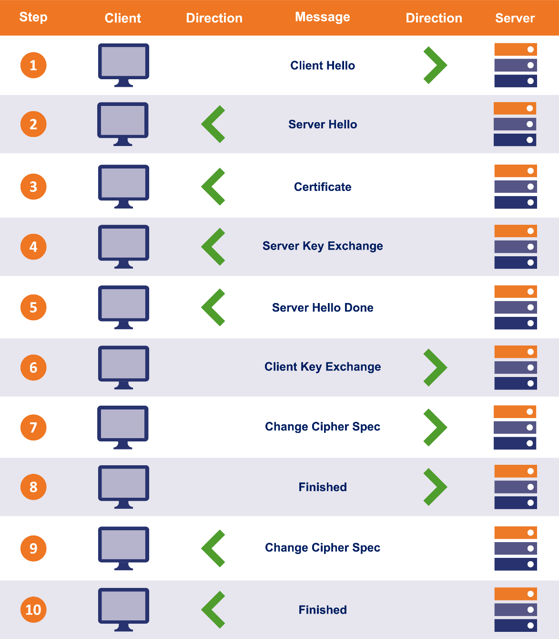
Differences in TLS 1.3
TLS 1.2 (and earlier versions)
Network security course

Slide 31
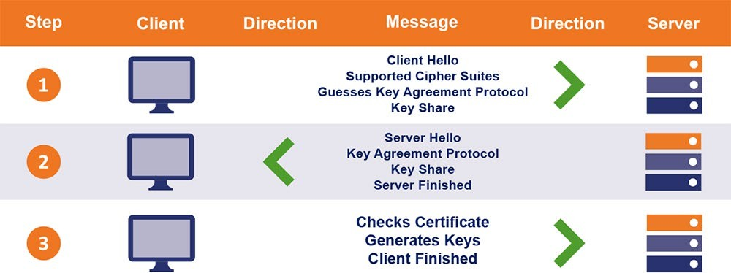
Differences in TLS 1.3
TLS 1.3
Network security course

Slide 32



TLS 1.3 Handshake
Alice
-Alice Hello
-Supported cipher suite
-Key share
Server
-Server Hello
-Chosen ciphers
-Key share
-Certificate & Signature
-Finished
-Finished
-HTTP GET
-HTTP answer
Network security course

Slide 33
TLS resumption
Network security course

Slide 34
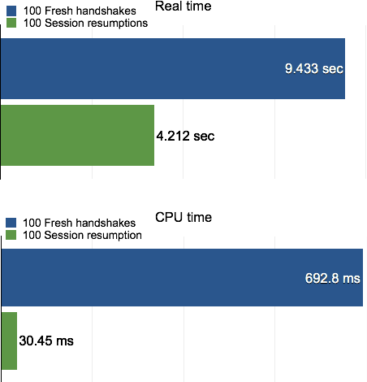
Most TLS connections are not new
If a client has visited a server before then a TLS resumption will occur
Much faster
TLS 1.2 and 1.3 do things differently
Network security course

Slide 35
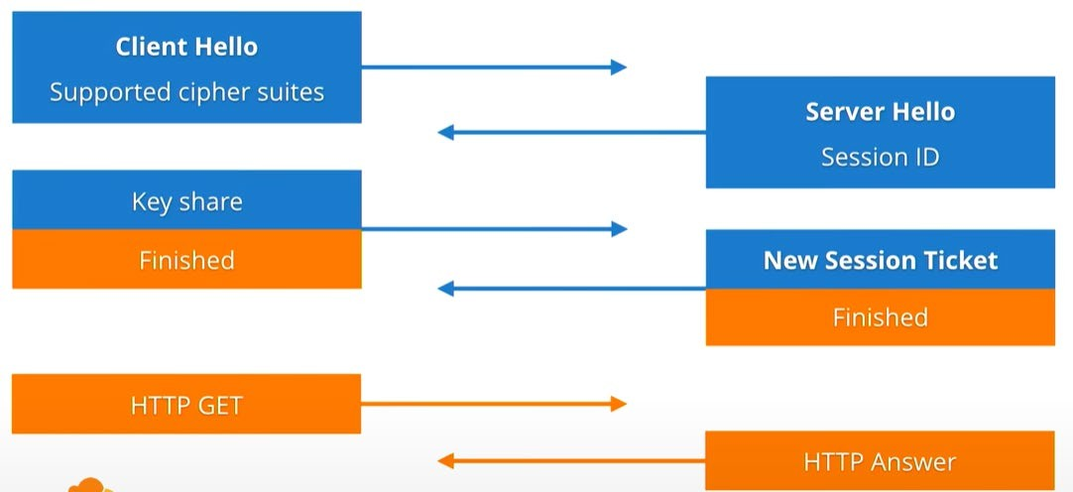
TLS 1.2 resumption
Reminder: full TLS 1.2 (and introducing session ticket)
Network security course

Slide 36
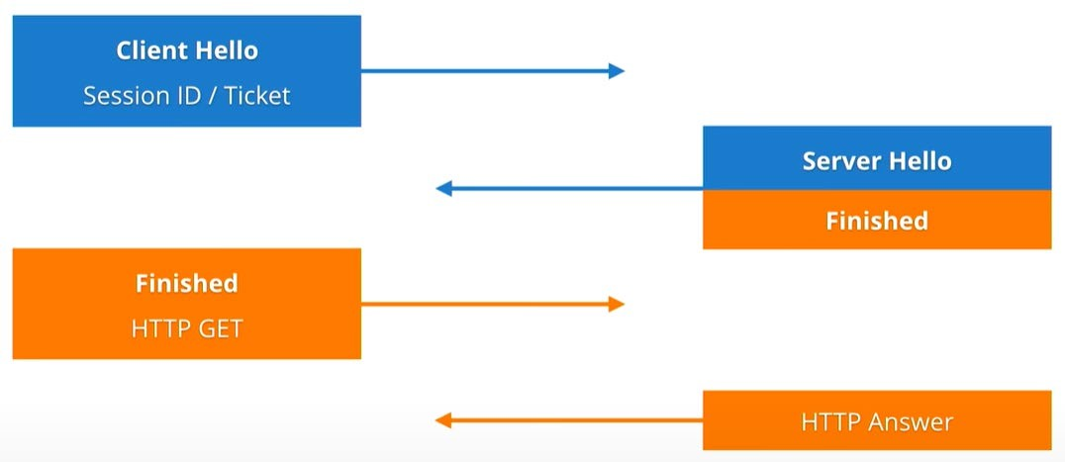
TLS 1.2 resumption
TLS 1.2 with resumption is 1-RTT
Network security course

Slide 37
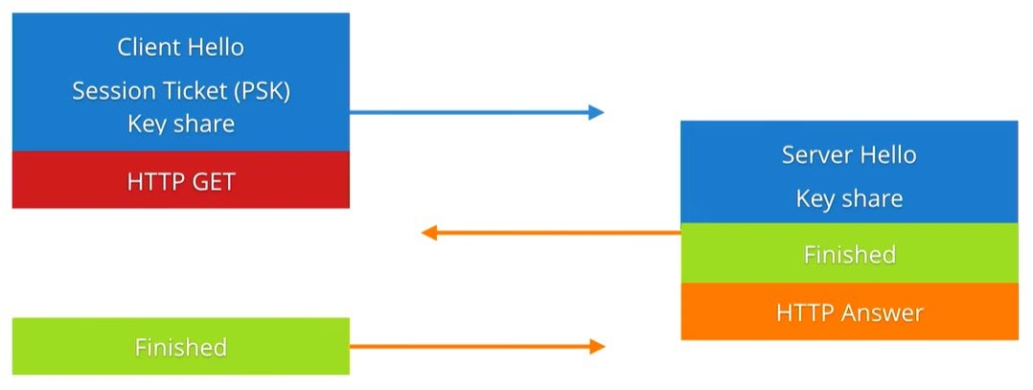
TLS 1.3 resumption 0-RTT
TLS 1.3 with resumption is 0-RTT
Network security course

Slide 38
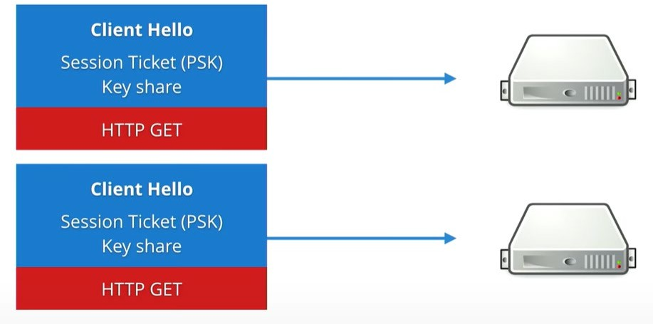
0-RTT limitations
No forward secrecy on early data
Early data replay attack on 0-RTT
Network security course

Slide 39

TLS 1.2 vs TLS 1.3
Much faster!
0-RTT via resumption
Old ciphers removed
AEAD ciphers
Version negotiation removed
Forward Secrecy (previous communication sessions remain secure even if the long-term private key of the server is stolen in the future)
• Much faster!
• 0-RTT via resumption
• Old ciphers removed
• AEAD ciphers
• Version negotiation removed
• Forward Secrecy
Network security course

Slide 40
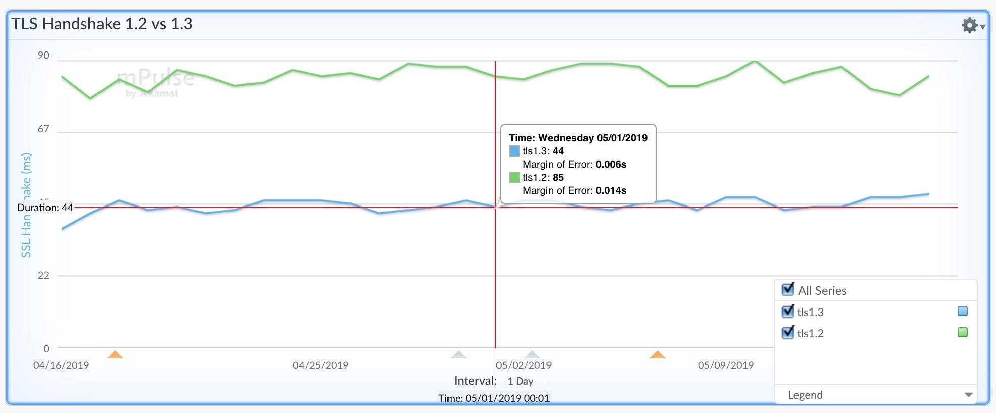
Network security course

Slide 41
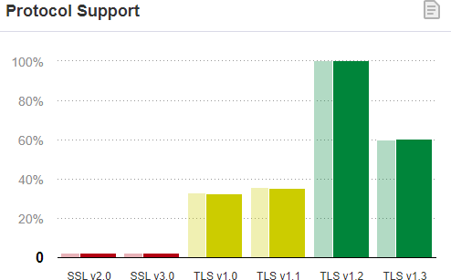
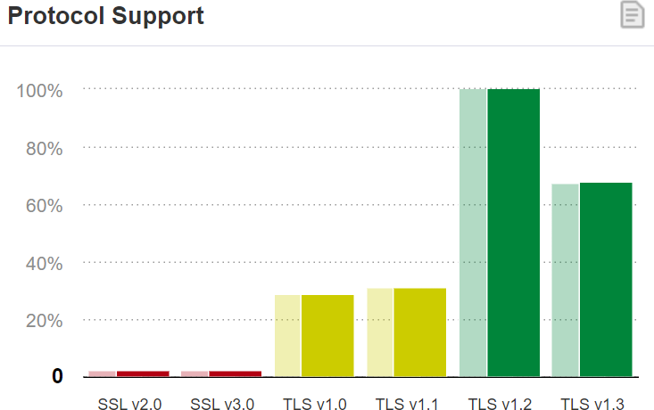
Protocol support
Source: https://www.ssllabs.com/ssl-pulse/
Network security course

Slide 42
Other TLS based Applications
DTLS: Datagram Transport Layer Security (DTLS) –Provides security for UDP datagrams
SMTPS: Simple Mail Transfer Protocol (SMTP) over TLS
IMAPS: Internet Message Access Protocol (IMAP) over TLS
POP3S: Post Office Protocol 3 (POP3) over TLS
DoT: Domain Name System (DNS) over TLS
FTPS: File Transfer Protocol (FTP) over TLS
IRCS: Internet Relay Chat (IRC) over TLS
…
Network security course

Slide 43
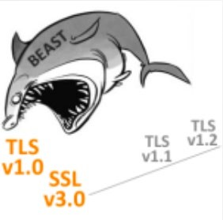
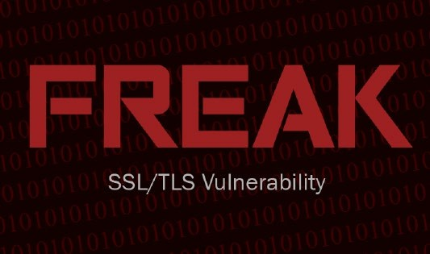




Attacks on ssl/tls

Slide 44
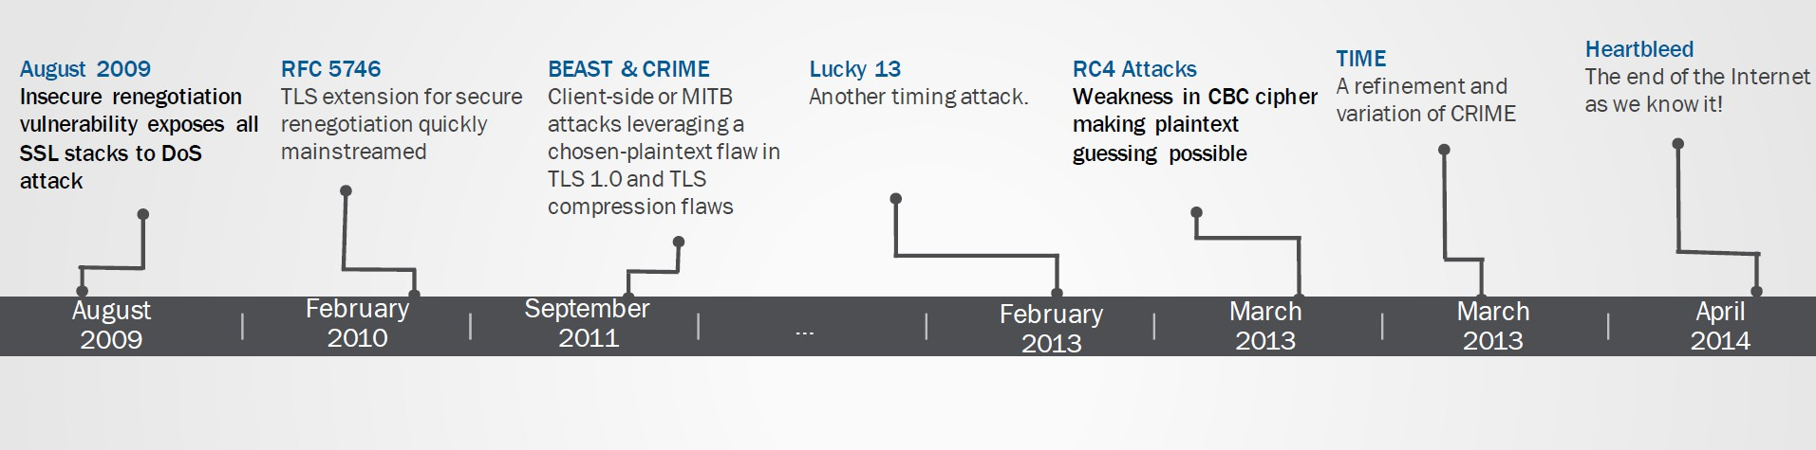
Network security course

Slide 45
Attacks on TLS
Not many that work against TLS 1.2 or 1.3:
Cipher-specific attacks (e.g., RC4)
Compression attacks (e.g., CRIME, TIME, BREACH)
Downgrade attacks (e.g., POODLE, FREAK)
Padding Oracle attacks (e.g., Lucky13)
Implementation attacks (e.g., Heartbleed)
Network security course

Slide 46
The most used practical attack: sslstrip
Original presentation: Moxie Marlinspike, Black Hat 2009
https://www.youtube.com/watch?v=MFol6IMbZ7Y
sslstrip is a tool that
– transparently hijacks HTTP traffic on a network
– watch for HTTPS links and redirects, and then map those links into look-alike HTTP links or homograph-similar HTTPS links
– also supports modes for supplying a favicon which looks like a lock icon, selective logging, and session denial.
Network security course

Slide 47

The most used (practical) attack
Original presentation: https://www.youtube.com/watch?v=MFol6IMbZ7Y
Network security course

Slide 48
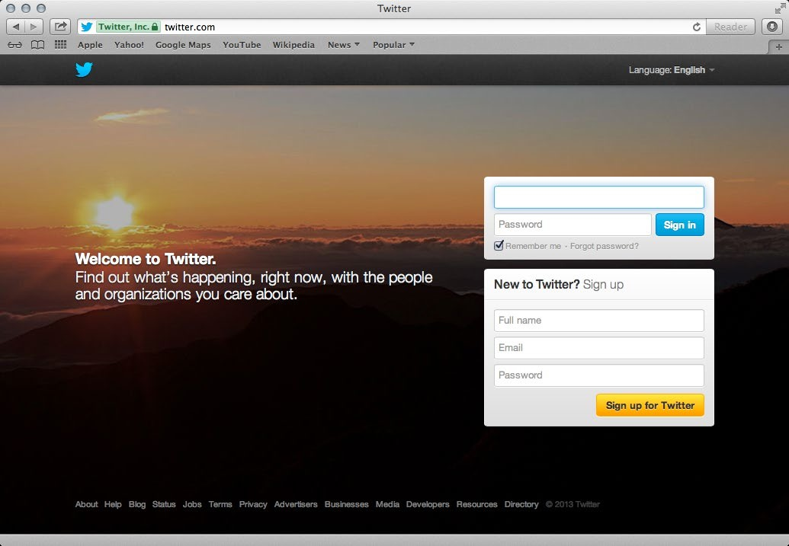
20 February
DTU Compute2024 Network security cour
se

Slide 49
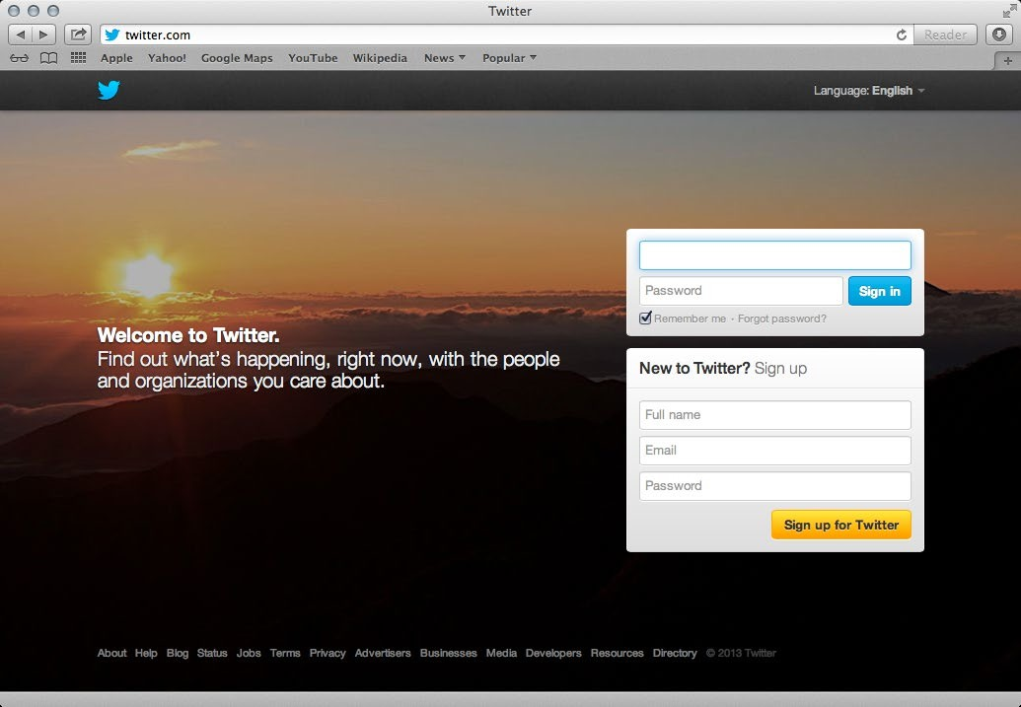
20 February
DTU Compute2024 Network security cour
se

Slide 50
Is it still possible? (usually not)
Depends on
–Website/server
–User
–Browser
Mitigation: HTTP Strict Transport Security
–Policy, RFC 6797
–Web-servers demand browsers to HTTPS only
Network security course

Slide 51
HTTP Strict Transport Security
Limitations
–Initial request still vulnerable
  The protection only applies after a user has visited the site at least once
–TLS attacks: e.g., Beast, Crime, etc. not mitigated
–DNS spoofing can circumvent the policy
Network security course

Slide 52
Network security course

Slide 53
Heartbleed at a glance
01.04.14
Implementation-specific bug of OpenSSL
Buffer-over-read type of vulnerability
Improper input validation (due to a missing bounds check) in the implementation of the TLS heartbeat extension
Huge impact (amazon, Github, Wikipedia, Tumblr, Reddit, etc.)
Network security course

Slide 54
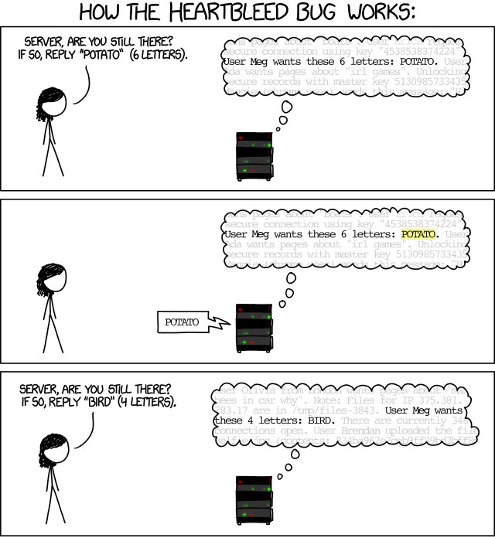
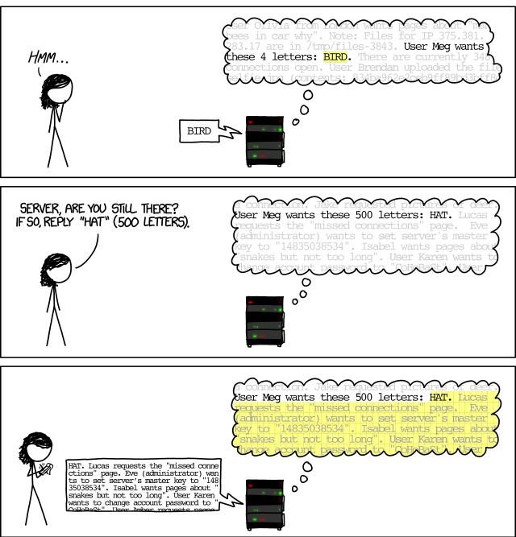
xkdc Heartbleed Explanation
Network security course

Slide 55
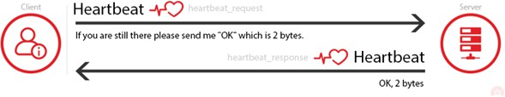
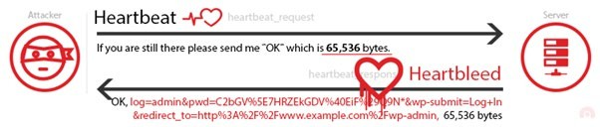
Heartbleed at a glance
Network security course

Slide 56
Some more attacks
Poodle attack (downgrade attack): https://www.youtube.com/watch?v=C8ks8WLoZto
Blackhat Asia 15, Bar-Mitzva Attack (RC4-based) https://www.youtube.com/watch?v=AHkUCD_EYok
FREAK attack (RSA downgrade attack) https://en.wikipedia.org/wiki/FREAK
Network security course

Slide 57

Some more attacks
The 9 Lives of Bleichenbacher's CAT: New Cache ATtacks on TLS Implementations
See: https://eyalro.net/project/cat.html
Works against TLS1.3 implementations too (by downgrading and attacking RSA)
Network security course

Slide 58
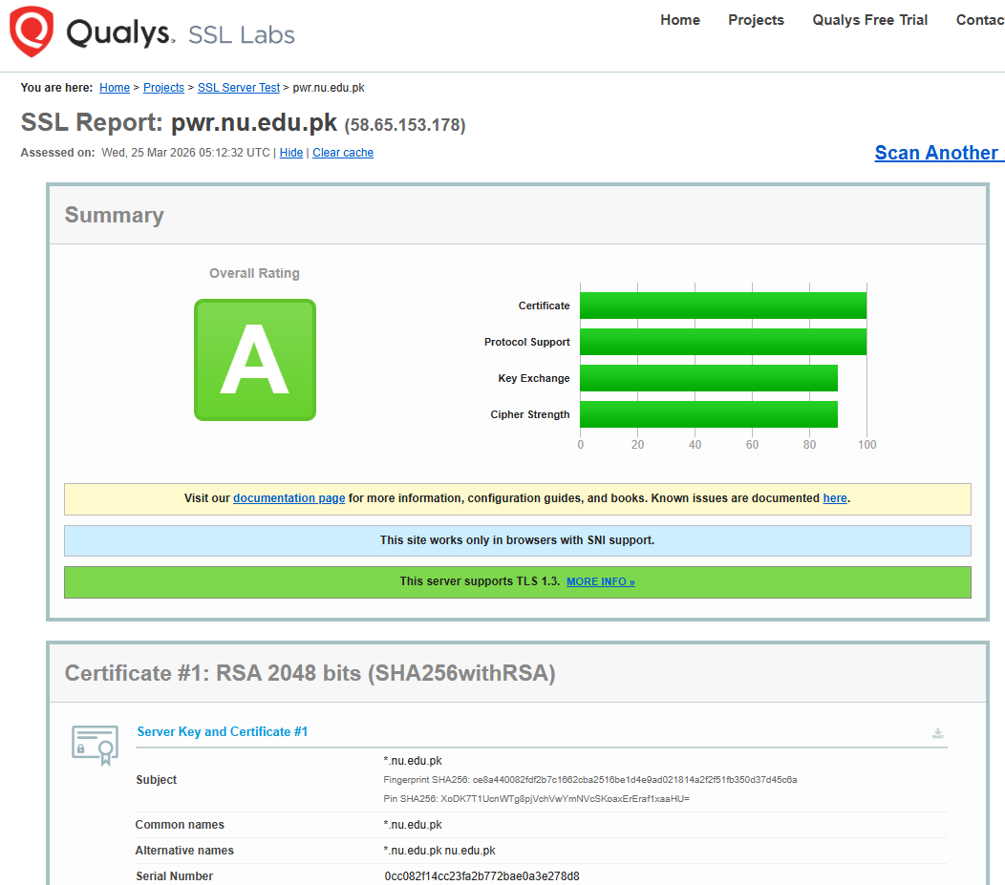
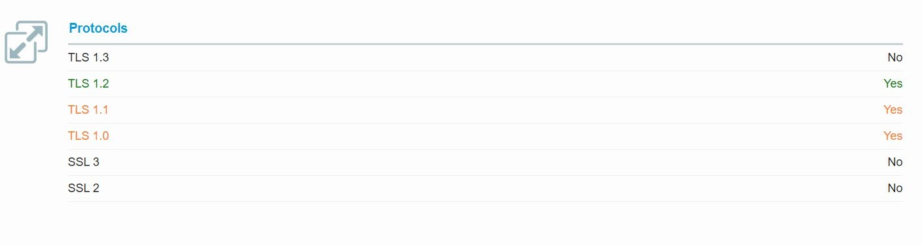
Testing TLS implementations
https://www.ssllabs.com offers a very nice scanning tool
Also
https://www.ssllabs.com/ssl- pulse/ provides some global statistics about TLS usage worldwide
Network security course

Slide 59
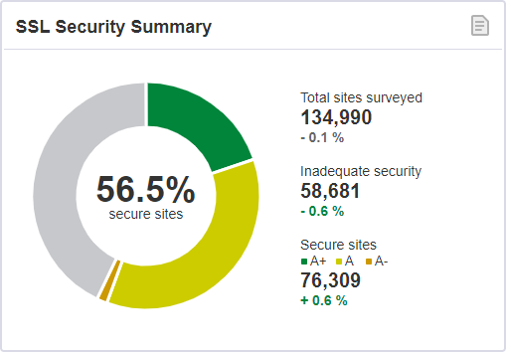
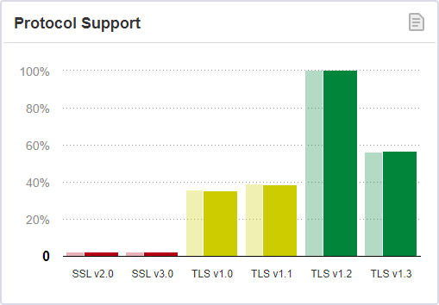
From (2023) https://www.ssllabs.com/ssl-pulse
Network security course

Slide 60
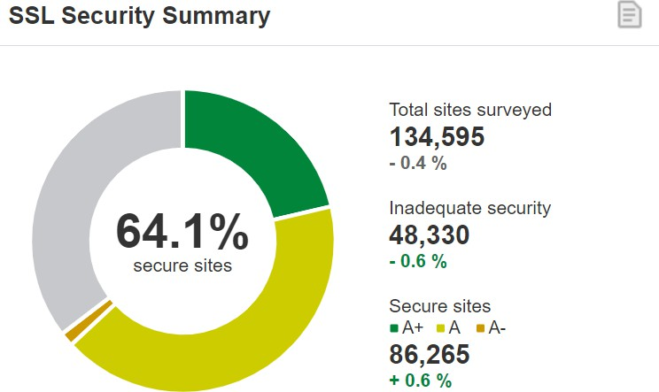
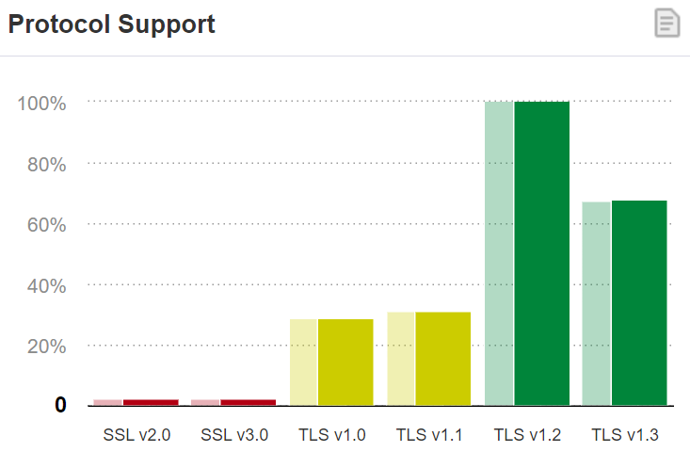
From (2024) https://www.ssllabs.com/ssl-pulse
Network security course

Slide 61
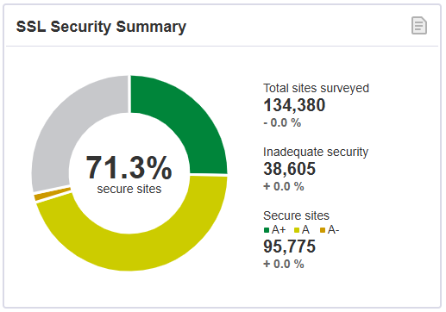
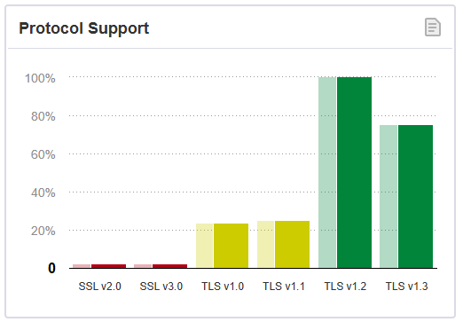
From (2025) https://www.ssllabs.com/ssl-pulse
Network security course

Slide 62
Conclusion
Transport Layer Security
–One of THE most important security protocols in use
–Various layers/sub-protocols
  Handshake is the most complicated one
–Remember that most connections are TLS Resumptions
–Used for many, many different things
  HTTPS, email (kinda), TOR, voip, etc.
Network security course

Slide 63

Further reading
Deploying TLS 1.3: the great, the good and the bad (33c3) from Cloudflare
  https://www.youtube.com/watch?v=0opakLwtPWk
Certificate transparency
  https://certificate.transparency.dev/
Network security course

